Slide 1
A Minimal Software-Defined Radio VHF/UHF/SHF Transceiver
KD2TAI, Zhemin Zhang
hisenzhang01@gmail.com
Microwave Update 04/14/2023

Slide 2

Speaker Bio
Hisen, KD2TAI.
Officially known as Zhemin Zhang.
Currently pursuing a B.S. in Computer Science dual Computer and Systems Engineering, focusing on digital communication and AI technologies.
President of the W2SZ college amateur radio club at RPI. Licensed as an Amateur Extra class operator since 2022.
ZHEMIN ZHANG
hisenzhang01@gmail.com

Slide 3
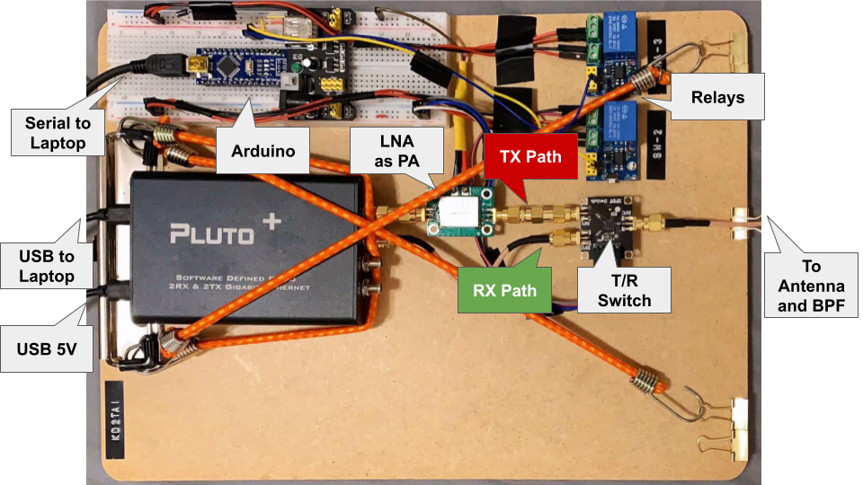
Agenda
Background
SDR
Existing Designs
System Design
Hardware
Software
Antenna and Filter
Evaluation
Lab Testing
Field Testing
Application
Future Work
Upgrade
New Mode
MIMO

Slide 4
Background

Slide 5
Software-Defined Radio
Software-defined radio (SDR) technology is becoming increasingly popular in amateur radio due to its:
Flexibility
All processing are done by software
Versatility
All modes, all bands
Higher bandwidth
Make no assumption about the signal

Slide 6
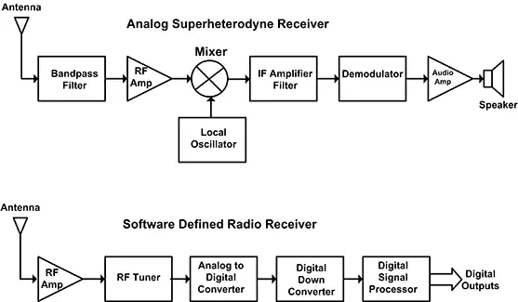
Traditional Receiver vs. SDR Receiver
Image by Digi-Key Electronics with permission to reprint

Slide 7
Existing Designs

Slide 8
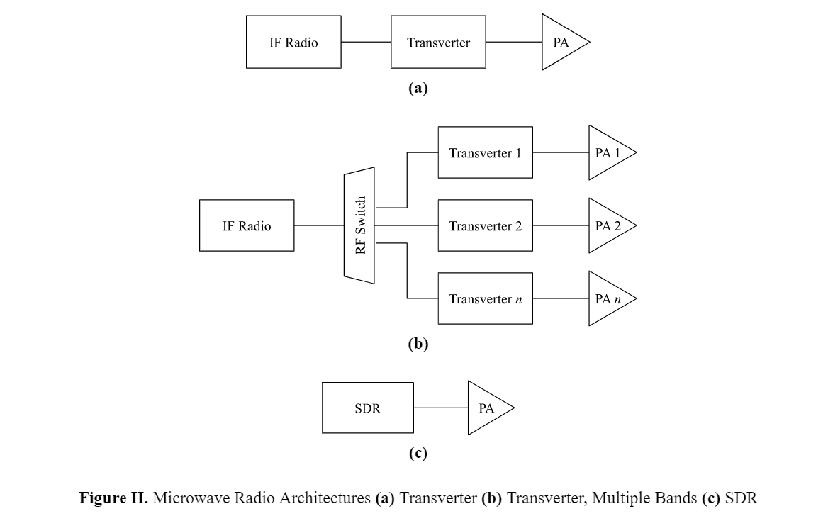

Slide 9
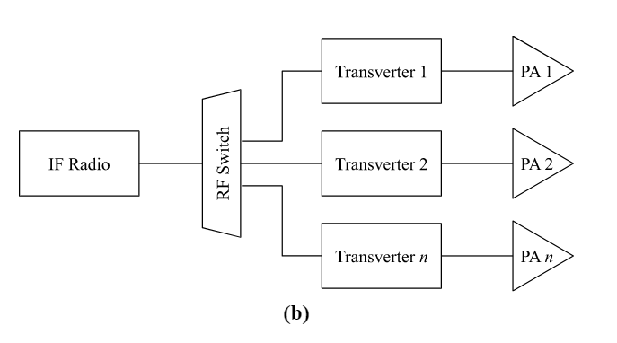
Existing Designs: Transverters
The current popular amateur microwave transceivers are mainly homemade with
a commercially available (“off-the-shelf”) intermediate frequency (IF) transceiver,
an n-way RF switch, connected to
transverters working on n-desired bands
IF ⇐ (transverter) ⇒ microwave
The RF switch activates one transverter at a time.
E.g., W1GHZ A four-band transverter solution for microwave rovers

Slide 10
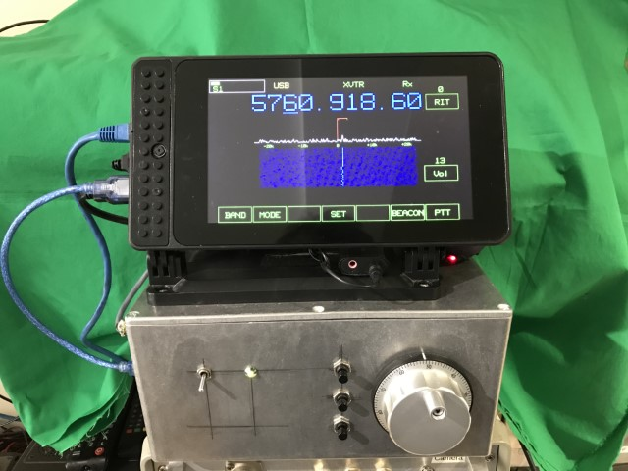
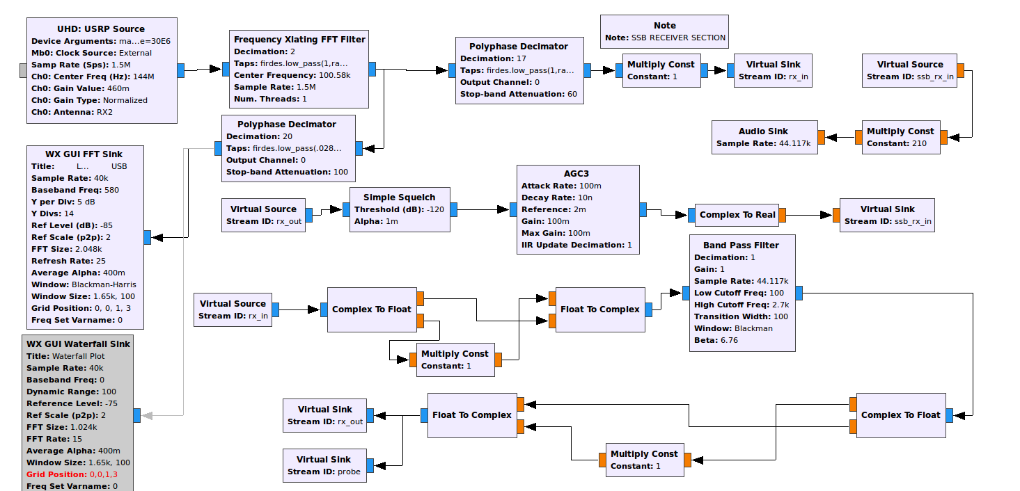


Existing Designs: Software-Defined Radios
W7FU Universal Microwave SSB/CW Transceiver (IF SDR)
G4EML Langstone project (Full SDR)

Slide 11
System Design

Slide 12
System Design Overview
“Less is more”
reduced component count and costs
improved robustness
144 MHz to 5.7 GHz
support mainstream amateur modes
Dimensions
LxWxH 32x23x3 cm
weight 0.7 kg

Slide 13
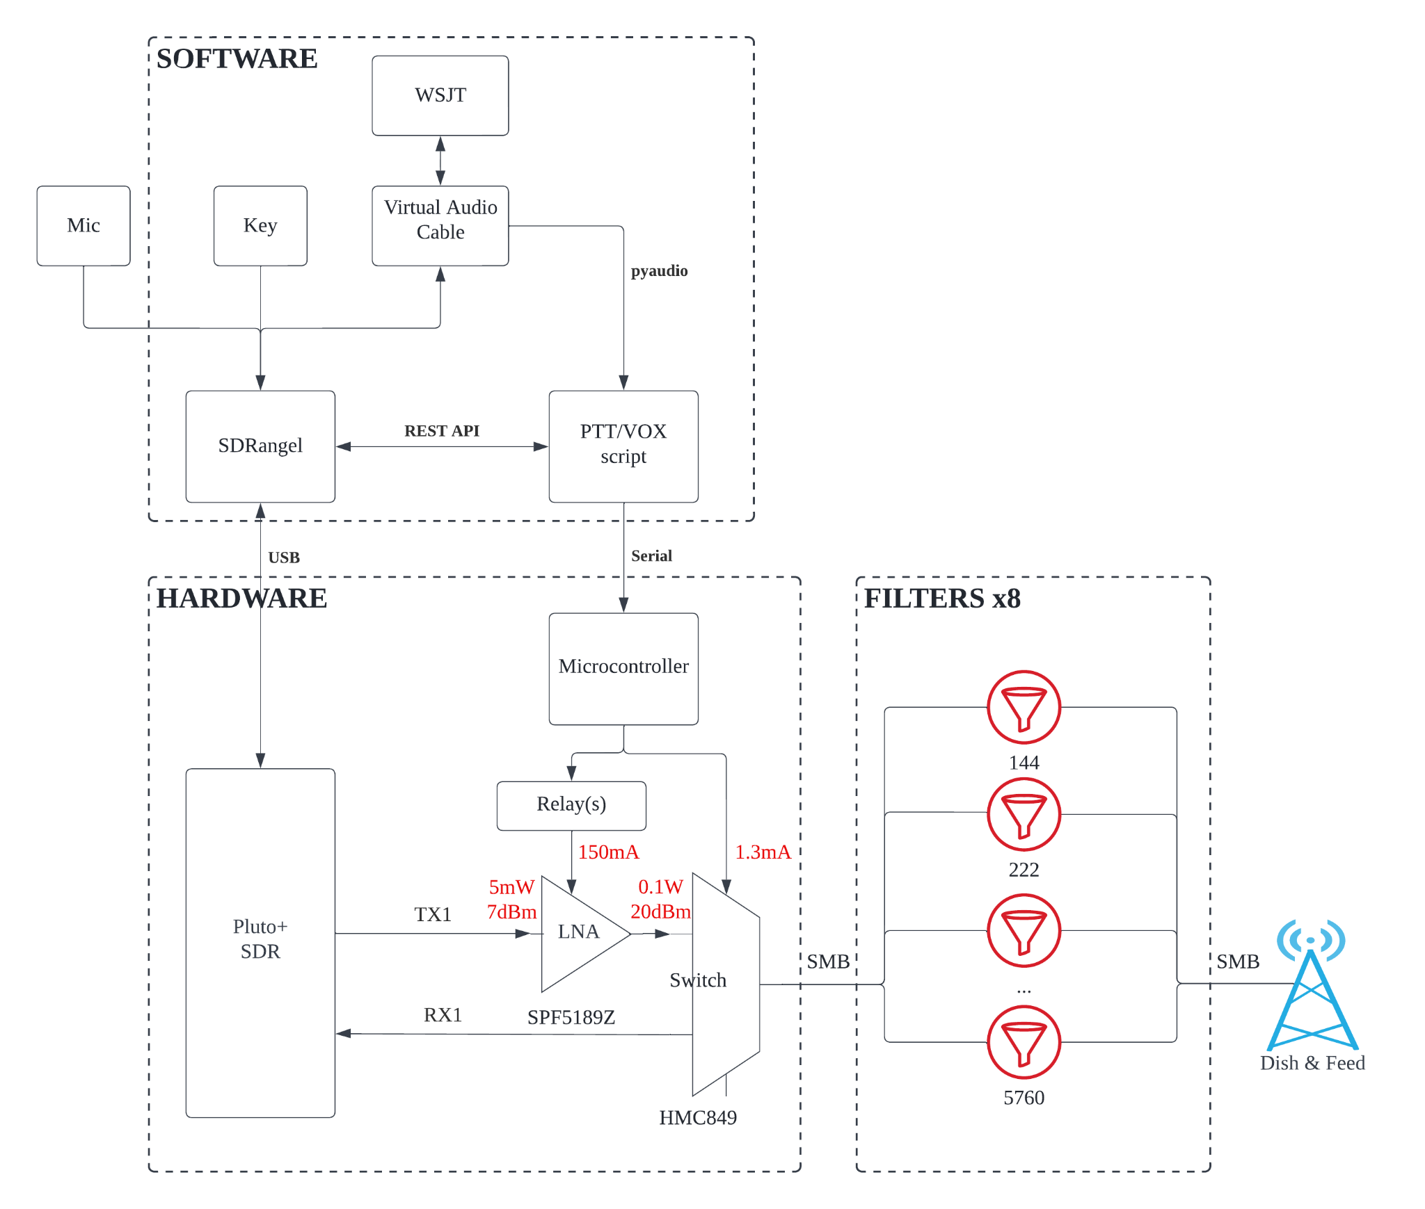

Slide 14
Hardware
Pluto+ SDR, AD9363: 2x2 MIMO, 12-bit DACs and ADCs.
SPF5189Z as the PA
HMC849 as the T/R switch
An Arduino toggling the switch and PA
Notes:
The system uses the Pluto+ SDR, a third-party modded version of Adalm Pluto SDR based on AD9363, a 2x2 transceiver chip with integrated 12-bit DACs and ADCs.
A gain block SPF5189Z functions as a wideband power amplifier because the SDR output power level is low.
A microcontroller (Arduino) listens for commands via a serial port and sets the relay and transmit/receive (T/R) switch status accordingly.
The T/R switch HMC849 connects the filter and antenna to TX1 and RX1 of Pluto+ for sharing the same antenna for transmission and reception.

Slide 15
Software
The kit running on a laptop includes:
SDRangel as the interface
A controller script as PTT or VOX
A two-way API for T/R switching
VB-CABLE redirecting audio
WSJT-X as the modem for digital modes

Slide 16
Antenna and Filter
Manual filter switching
SMB connectors
Snap-on for quick rewiring
Two antennas:
A whip for 144 MHz and 432 MHz
A log periodic yagi PCB for 800 MHz - 6 GHz.

Slide 17
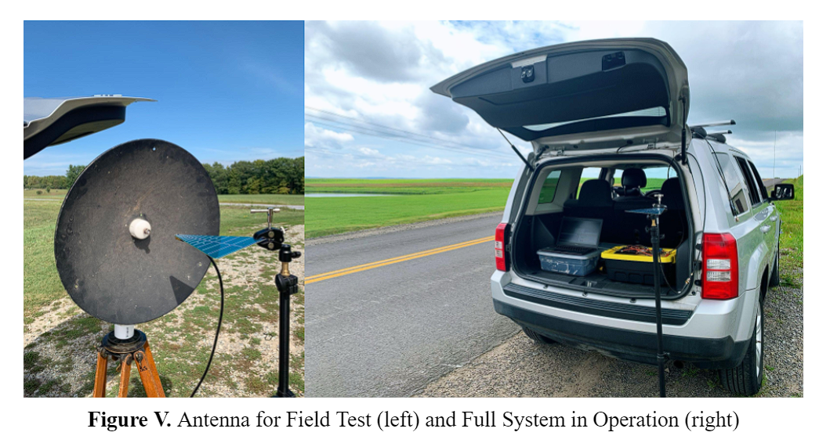

Slide 18
Evaluation

Slide 19
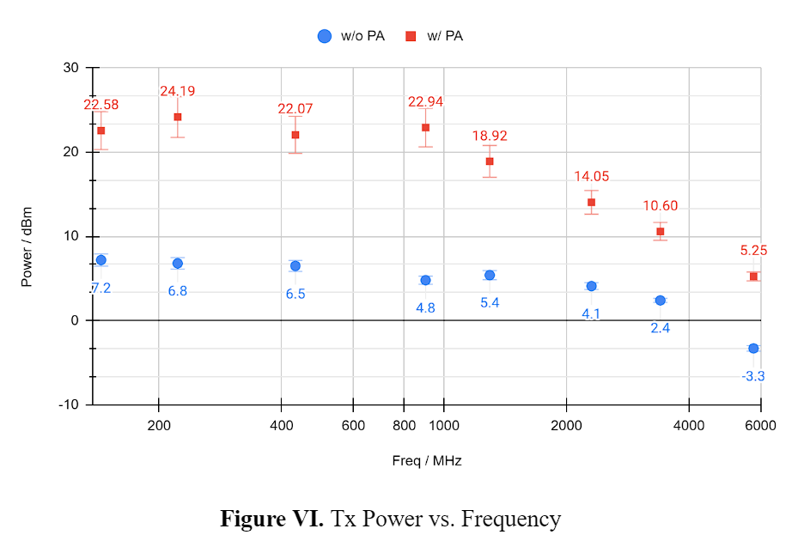

Slide 20
Spurious Emission
Output has strong odd harmonics
Filtering is necessary
Exploiting the harmonics…
to transmit on frequencies above the hardware limit (Langstone project)
Tx_att = 10dB @ 500MHz
1st 500Mhz -1.8dBm
2nd 1GHz -51dBm
3rd 1.5GHz -11.2dBm
4th 2GHz -54dBm
5th 2.5GHz -18.6dBm
Source: https://www.eevblog.com/forum/rf-microwave/adalm-pluto-sdr/msg1290682/#msg1290682

Slide 21
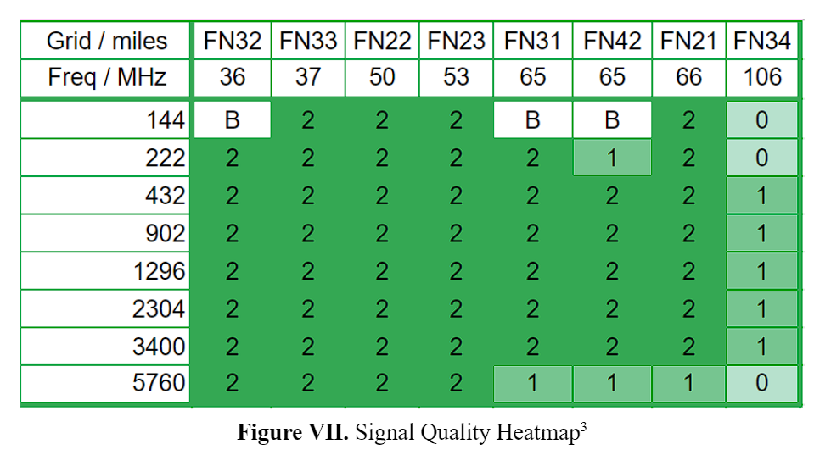
Field Test
In the best case:
FT8 on 902 and 1296 MHz over 132 miles
CW from 432 through 3400 MHZ over 106 miles
For around 100mW, the system supports decent signal quality for SSB mode up to 66 miles and CW mode over 100 miles of line-of-sight path.
2, 1, and 0 stand for good, fair, and poor communication quality.
“B” means the other station was too busy to answer.

Slide 22
Application

Slide 23
STEM Education
Pluto SDR is an affordable and simple system suitable for school projects.
The system has official Python, MATLAB, and Simulink support and teaching resources for STEM education.
Pluto SDR is compatible with GNU Radio, an open-source radio framework for fast prototyping.

Slide 24
Preliminary Equipment Testing
SDR's wide operating frequency and modulation support make it suitable for simple equipment testing.
It can benchmark the receiving performance of a handheld transceiver (HT) and test a desktop unit's sideband output, all in one device.
However, SDR setups cannot replace lab-grade instruments for limited precision and accuracy.

Slide 25
Amateur Radio Contesting
Microwave stations are relatively rare in contests due to the high barrier of entry (equipment and knowledge).
Rover stations are common in VHF contests to activate additional bands and locations by traveling to multiple geographical grids and operating portable equipment.
The proposed setup powered by a standard 5V supply is lightweight and small enough for portable operations.

Slide 26
Future Work

Slide 27
Hardware Upgrade
GPSDO - Mini Precision GPS Reference Clock
Typical phase noise at 10MHz output:
-70 dBc/Hz at 1 Hz
-100 dBc/Hz at 10 Hz
-125 dBc/Hz at 100 Hz
-145 dBc/Hz at 1 kHz
-150 dBc/Hz at 10 kHz
-153 dBc/Hz at 100 kHz
-155 dBc/Hz at 1 MHz
Power Amplifier - TBWA2/20dB
Noise Figure @ 2GHz: 4.5 … 5 dB
Freq | Gain dB | Freq | Gain dB
1M | 14.8 | 1G | 19.8
10M | 20.2 | 2G | 19
100M | 20.2 | 3G | 17.6
500M | 20 | 4.5G | 17.4
 |  | 6G | 15.4
Notes:
Hardware upgrade candidates

Slide 28
Software Upgrade
Developing dedicated software kits yields several benefits:
Easier system configuration
Reduced system performance requirements
Reduced power consumption

Slide 29
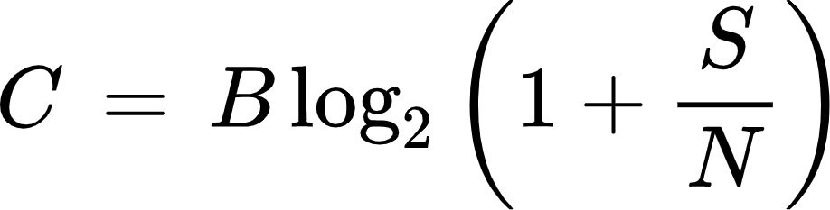
Spread Spectrum Modes
Better interference rejection
Lower power density
Bandwidth on microwave bands
Legal limit: 100kHz
AFSK: 2.8kHz
Shannon-Hartley theorem:
B - bandwidth in hertz
S, N - power in watts for received signal and noise

Slide 30
MIMO - Multiple Input, Multiple Output.
Improves capacity, range, and reliability
Increase throughput in multipath channels
Beam steering

Slide 31
THE END.

